Slide 1

Deep Learning based Text Processing
2022
Lec 10: Introduction to Long-Short Term Memory
hsyi@kisti.re.kr
Hongsuk Yi (이홍석)

Slide 2
Overview of Course
Introduction to Recurrent Neural Network
Simple RNN, BPTT, Memory Cell
Code: Implementing an RNN with Keras
Introduction to Long-Short Term Memroy
Cell state, LSTM, and GRU, and Applications
A Visual Guide to Recurrent Layers in Keras
Code: A simple LSTM layers
Text generation with RNN
Tokenizer, Character-Level Language model
Code: Alice’s Adventures in Wonderland
Sequence to Sequence Learning model with RNN
Introduction to Seq2Seq and Attention model
Code: Character-Level Neural Machine Translation

Slide 3
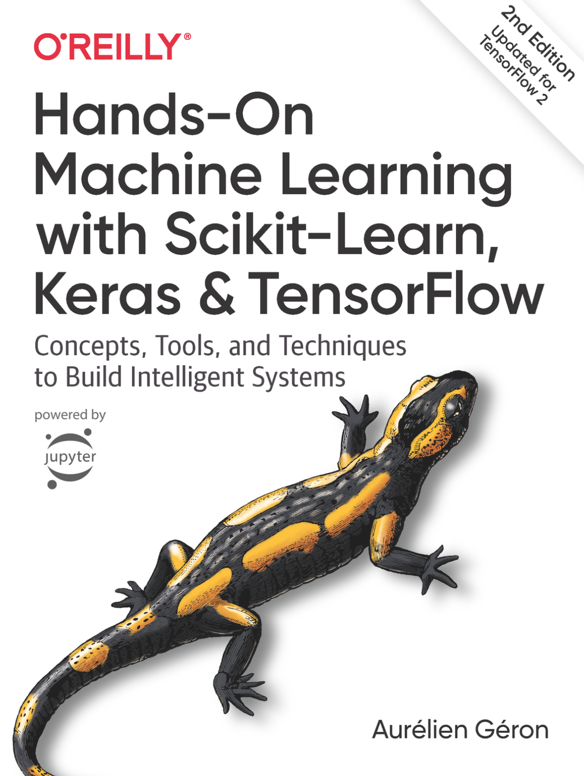
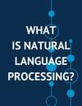
Reference Materials
딥 러닝을 이용한 자연어 처리 입문
https://wikidocs.net/book/2155

Slide 4
Reviewing the last class: RNN

Slide 5
Recurrent NN for processing sequences
RNN can handle interactions more flexibly
they are applied in a step-by-step fashion to a sequential input
a sequence of words, characters, or something else
RNNs use a state representing what has happened previously
after each step, a new state is computed

Slide 6
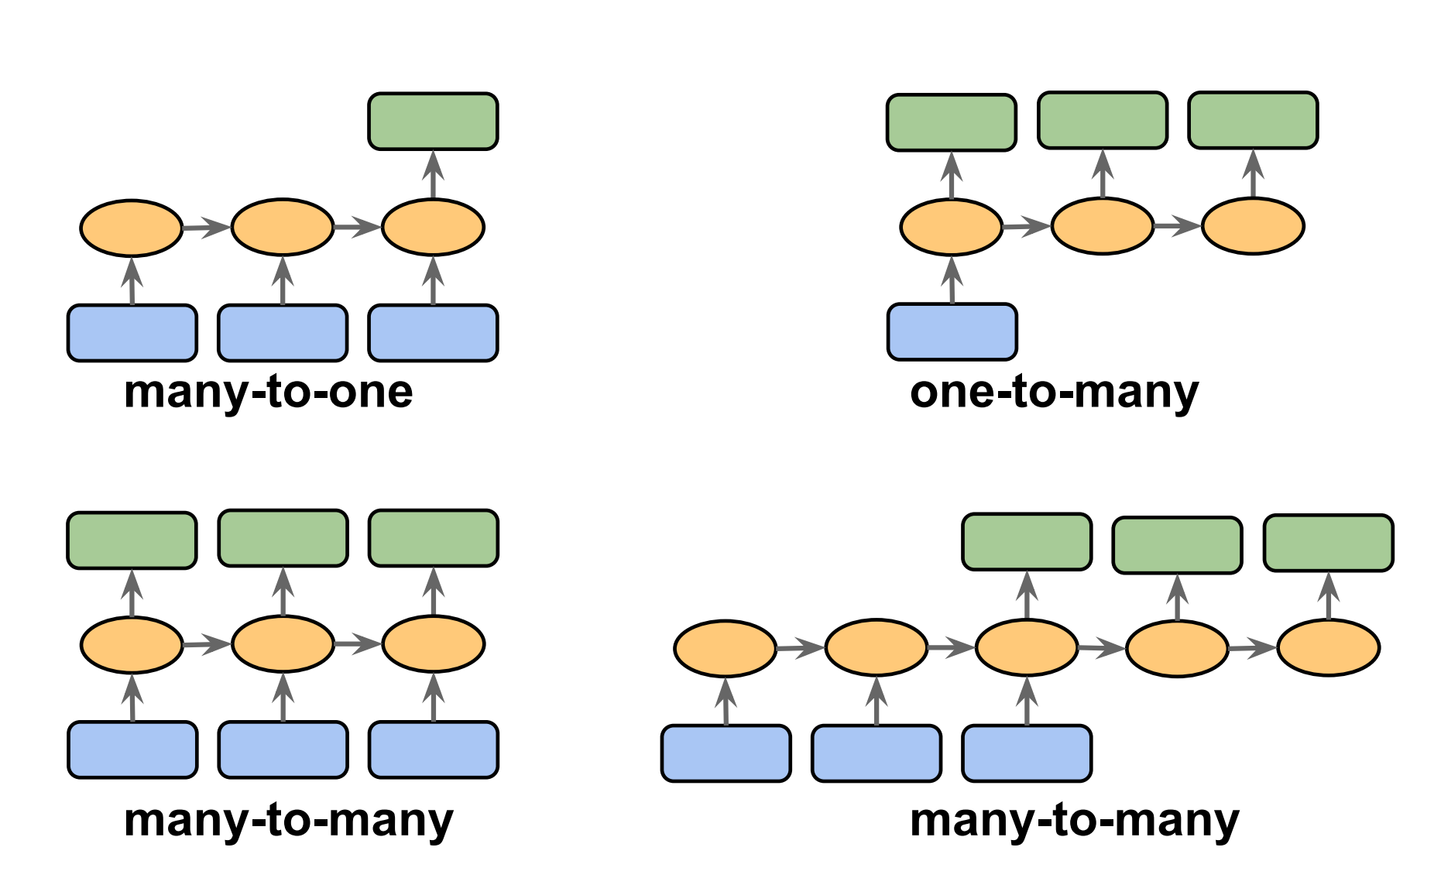
Different Types of Sequence Modeling Tasks

Slide 7
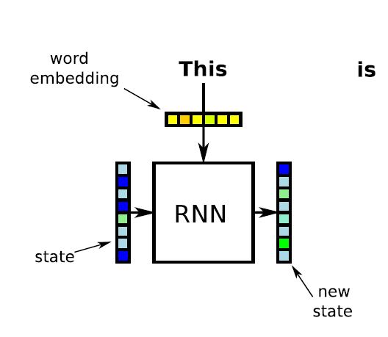
RNN example
https://chalmers.instructure.com/courses/16100
image borrowed from Richard Johansson (Chalmers Technical University and University of Gothenburg)

Slide 8
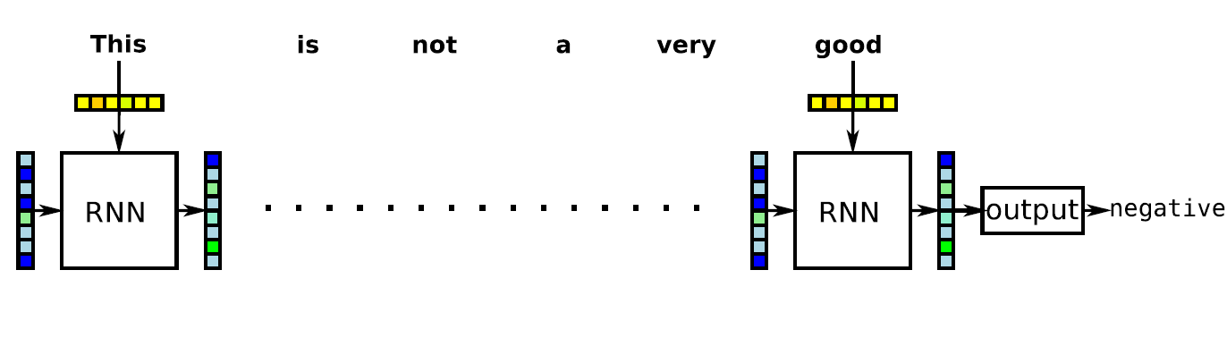
training RNNs: backpropagation through time
image borrowed from Richard Johansson (Chalmers Technical University and University of Gothenburg)

Slide 9
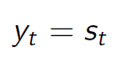
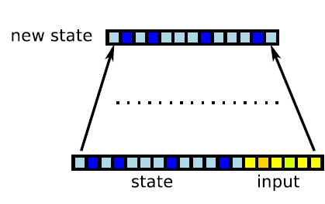
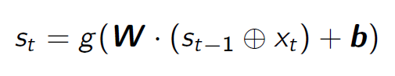
simple RNN implementation
the simple RNN looks similar to a feedforward NN
the next state is computed like a hidden layer in a feedforward NN
the output is identical to the state representation:
actication is typically tanh
image borrowed from Richard Johansson (Chalmers Technical University and University of Gothenburg)

Slide 10
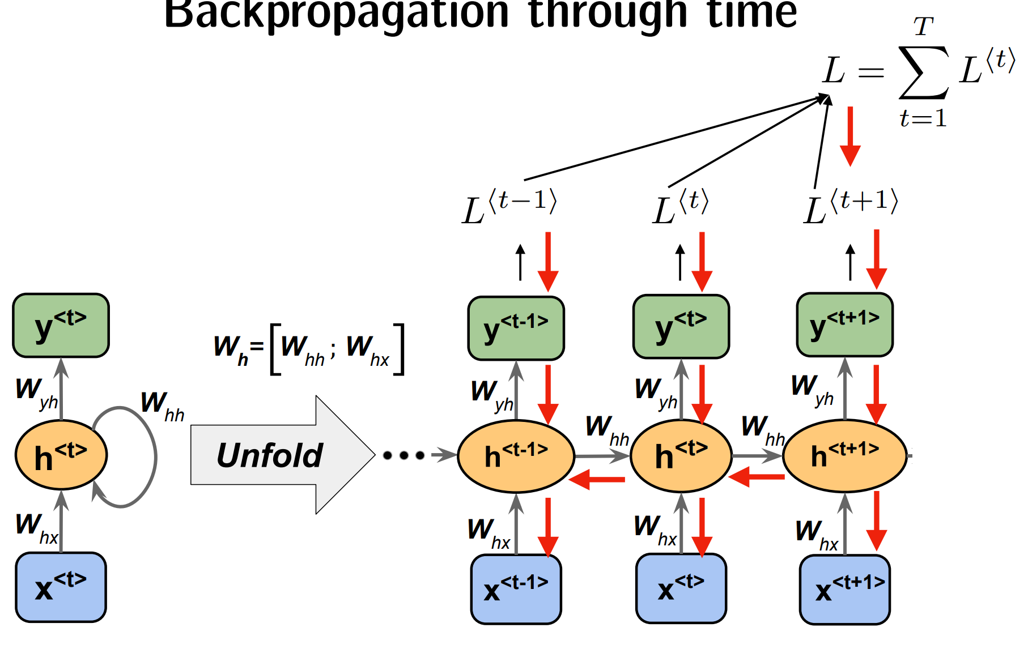
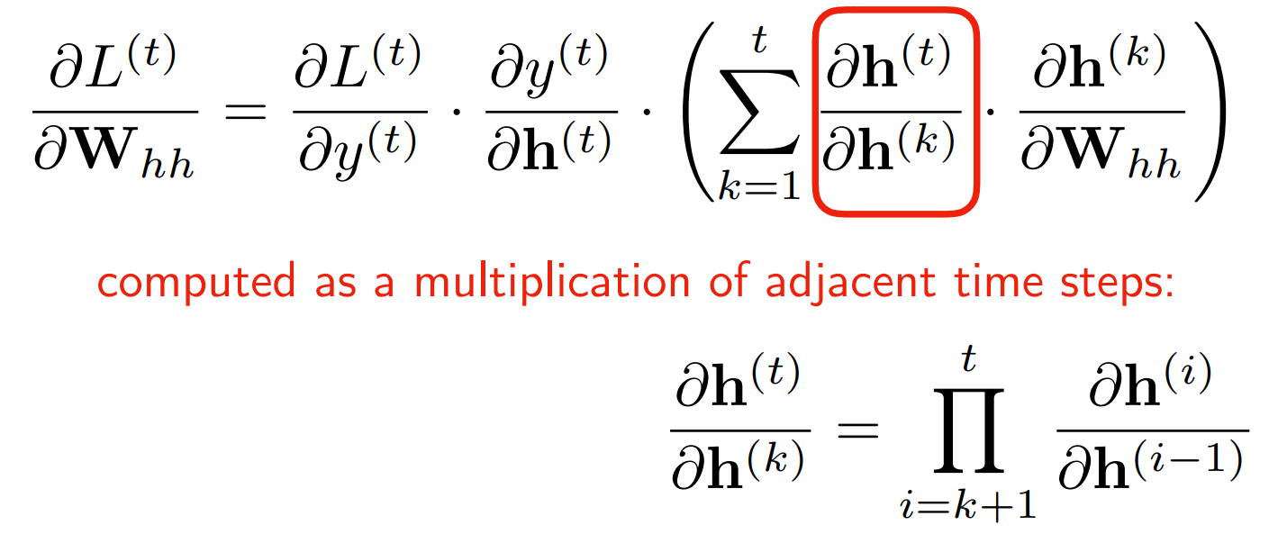
backpropagation through time
To train an RNN the trick is to unroll it through time and then simply use regular backpropagation.
Backpropagation through time (BPTT)

Slide 11
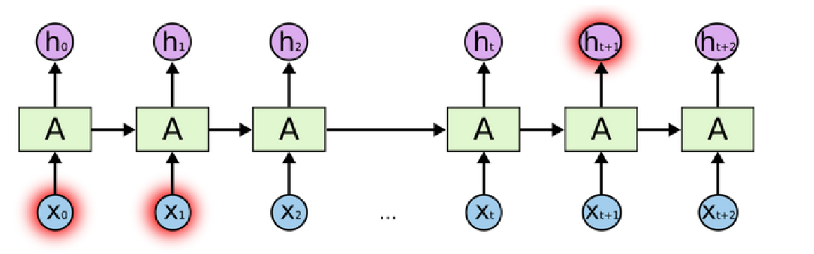
simple RNNs have a drawback
simple RNNs suffer from the problem of vanishing gradients (Hochreiter, 1998)
image borrowed from Richard Johansson (Chalmers Technical University and University of Gothenburg)

Slide 12
Solutions to the vanishing/exploding gradient problems
Truncated backpropagation through time (TBPTT)
simply limits the number of time steps the signal can backpropagate after each forward pass.
E.g., even if the sequence has 100 elements/steps, we may only backpropagate through 20 or so
Long short-term memory (LSTM)
uses a memory cell for modeling long-range dependencies and avoid vanishing gradient problems
Gradient Clipping
set a max value for gradients if they grow to large
solves only exploding gradient problem)

Slide 13
Long-Short Term Memory (장단기 메모리)

Slide 14
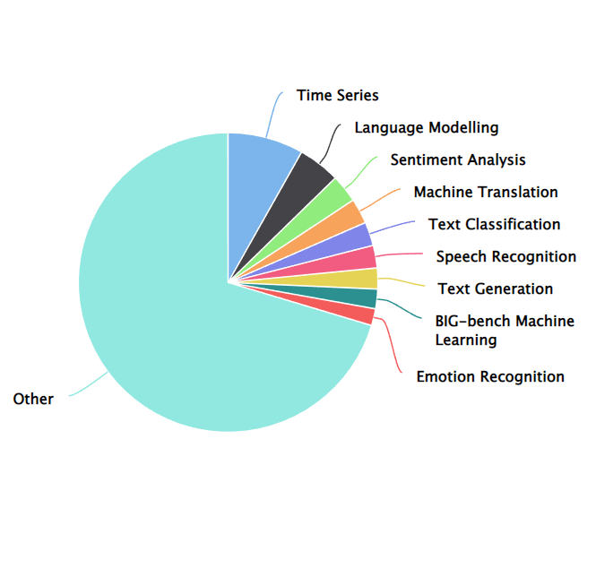
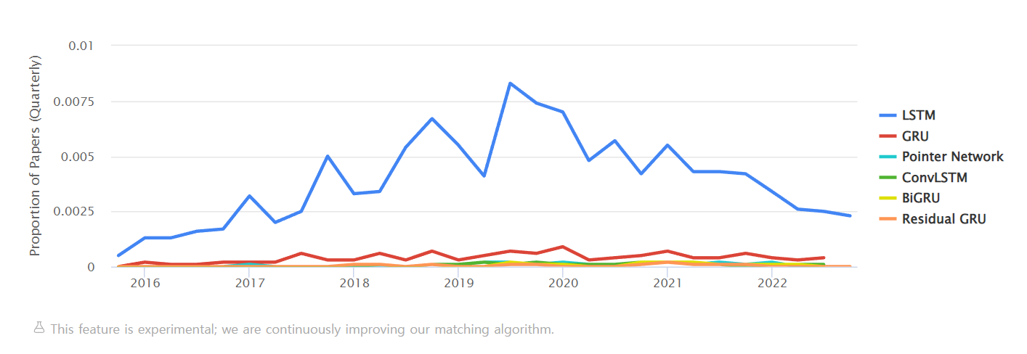
LSTM Tasks and Usage Over Time : 2022
<source> https://paperswithcode.com/method/lstm

Slide 15
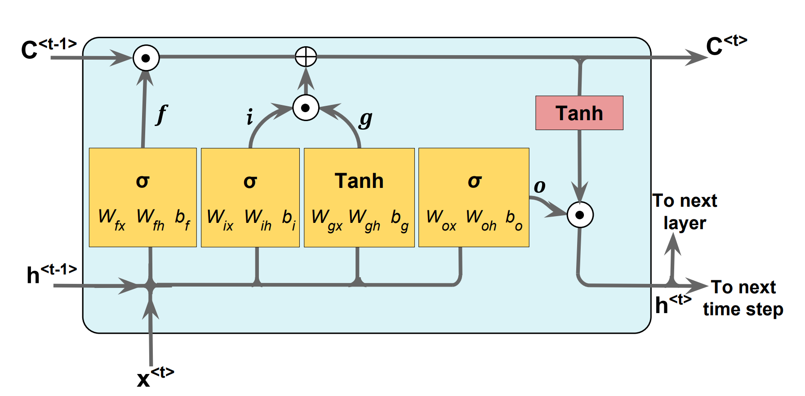
Long-short term memory (LSTM)

Slide 16
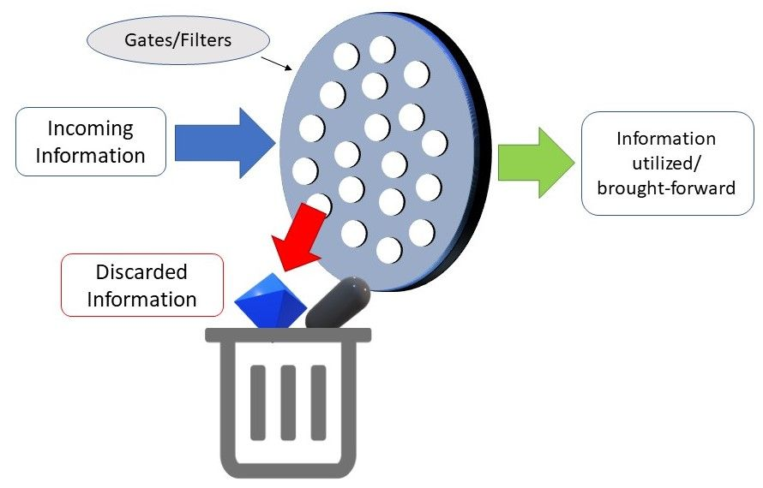
Cell states and Gates
Cell state
Gates control the flow of information to/from the memory
4
3
2
1

Slide 17
Understanding the roles played by gates in LSTM
Forget Gate
whether we should keep the information from the previous timestamp or forget it
Input Gate
Decide how much this unit adds to the current state
New information: Memory Upgate
The cell state vector aggregates the two components (old memory via the forget gate and new memory via the input gate)
Output Gate
Decide what part of the current cell state makes it to the output

Slide 18
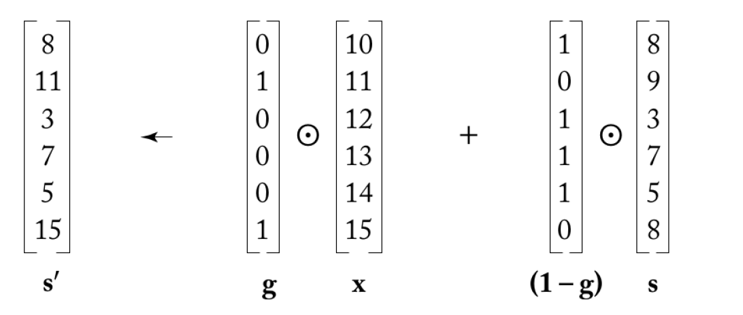
gating
gating architectures allow information flow to be controlled more carefully
should we copy the previous state, or replace it?
image borrowed from Richard Johansson (Chalmers Technical University and University of Gothenburg)

Slide 19
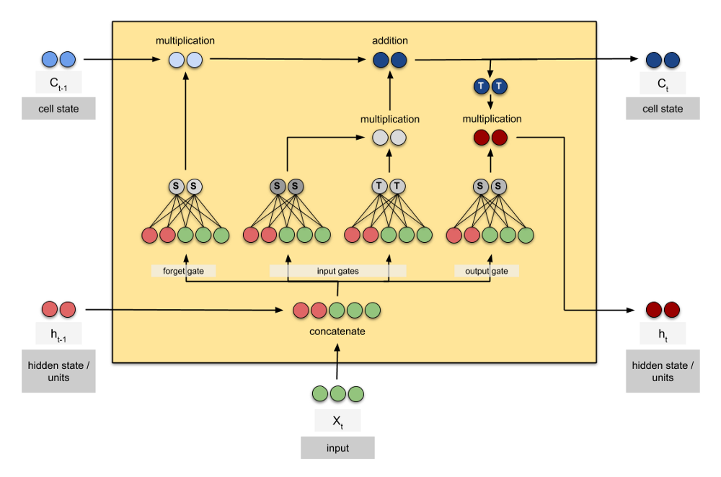
LSTM : Cell state and hidden state
Gates are controlled by a concatenation of the output from the previous time step and the current input and optionally the cell state vector.
S: Sigmoid
T: tanh

Slide 20
Gated Recurrent Units (GRU)

Slide 21
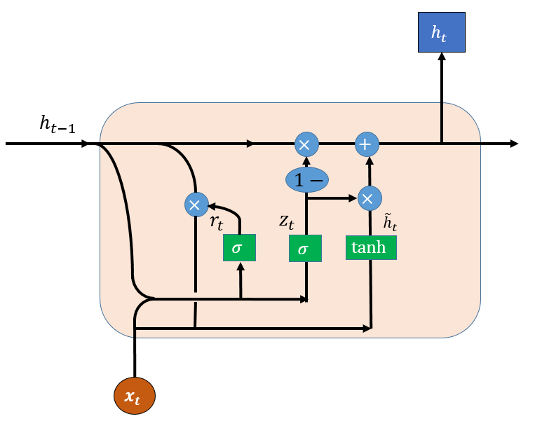
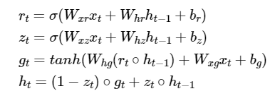
Gated Recurrent Units (GRU, 게이트 순환 유닛)
Just like LSTM, GRU uses gates to control the flow of information.
GRU simplifies the architecture of LSTM, which was similar in performance to LSTM and was complex
source: https://www.researchgate.net/figure/Structure-of-a-GRU-cell_fig1_334385520

Slide 22
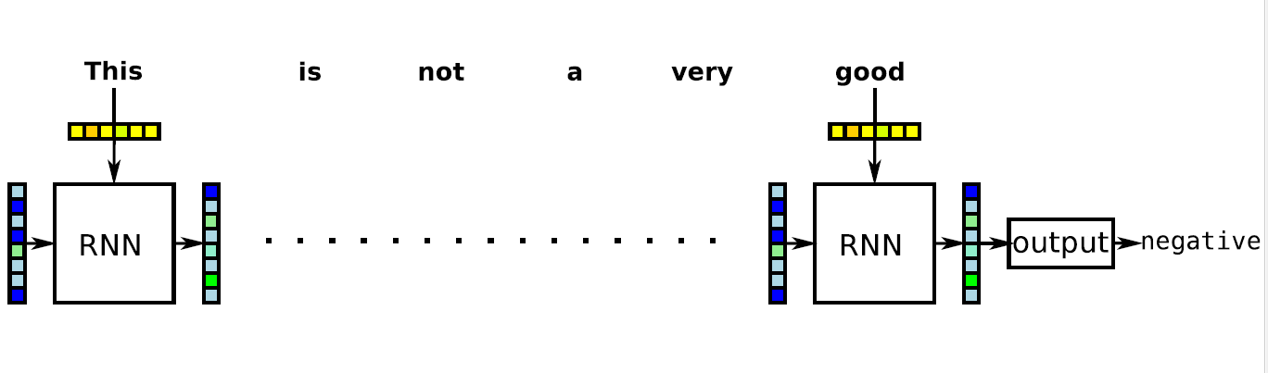
limitations of RNNs
Even with gated RNNs, it can be hard to cram the useful information into the last state
image borrowed from Richard Johansson (Chalmers Technical University and University of Gothenburg)

Slide 23
Simple LSTM layer

Slide 24
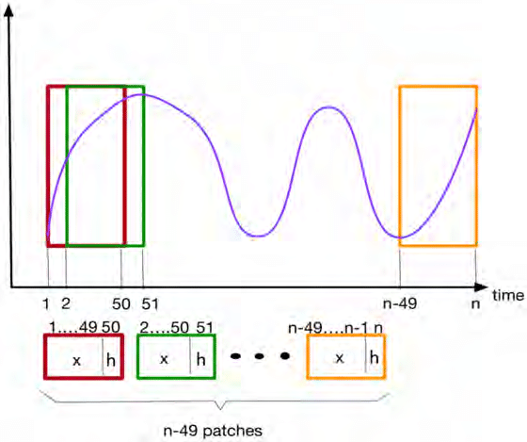
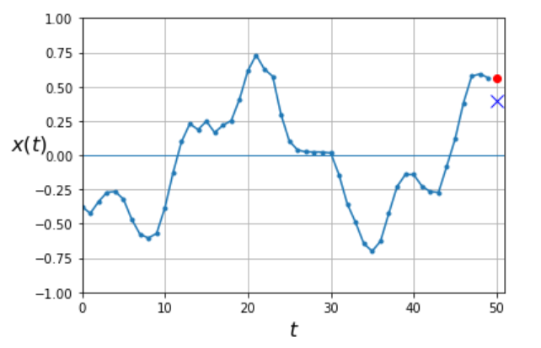
RNN Sliding window size and horizon

Slide 25
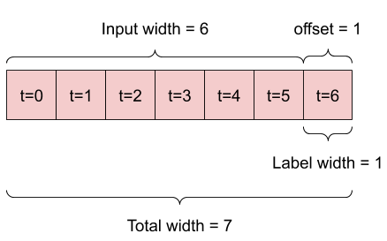
Data windowing
A model : prediction one hour into the future, given six hours of history

Slide 26
Many-to-One RNN Data Structure
Step1: set the number of window_size, horizon
Window_size = 7
Horizon=5
Step2: set the number of window_size, horizon

Slide 27
LSTM Parameters
LSTM has 3 important parameters
neurons : dimensionality of the output space
return_sequences: whether to return the last output. (hidden state, memory cell,h)
in the output sequence, or the full sequence.
Default: False.
return_state: whether to return the last state in addition to the output. (cell state, c)
Default: False.

Slide 28
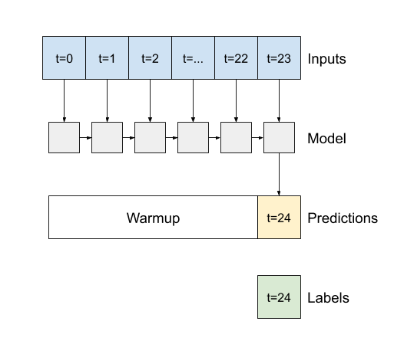
return_sequences=False (the default)
Return_sequences=False
the layer only returns the output of the final time step
giving the model time to warm up its internal state before making a single prediction:

Slide 29
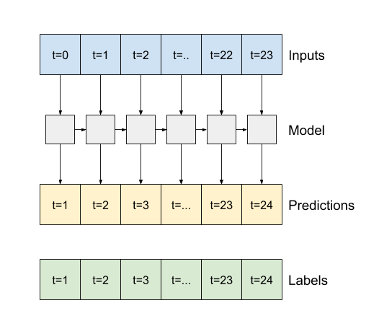
return_sequences=True
Return_sequences=True
the layer returns an output for each input. This is useful for Stacking RNN layers.
Training a model on multiple time steps simultaneously

Slide 30
a sequence modeling problem : predict the next word

Slide 31
Why Sequence Models?
a sequence modeling problem
“This morning I took the dog for a
walk.”
given these words
predict what comes next?

Slide 32
Why Sequence Models?
idea: use a fixed window
“This morning I took the dog
for a
walk.”
[ 1 0 0 0 0 0 1 0 0 0 ]
given these 2 words, predict what comes next?
for a
One hot feature vector
indicates what each word is
prediction

Slide 33
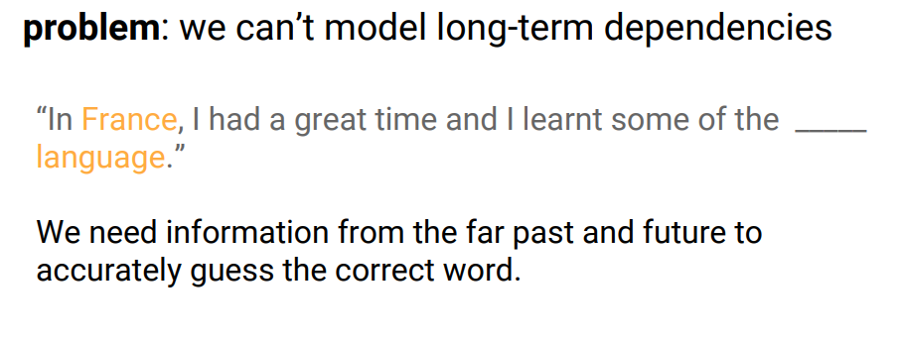
Why Sequence Models?

Slide 34
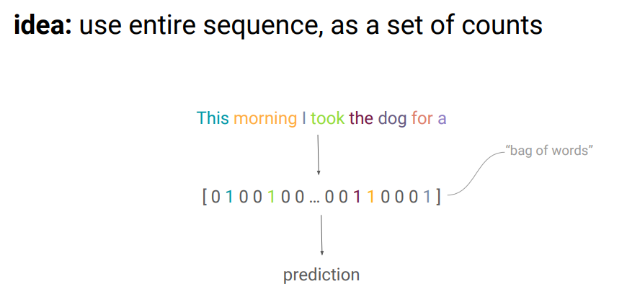
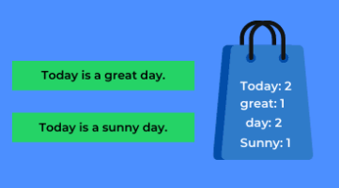
Why Sequence Models? Bag of words
Bag-of-words model:
In this model, a text (such as a sentence or a document) is represented as the bag (multiset) of its words, disregarding grammar and even word order but keeping multiplicity.

Slide 35
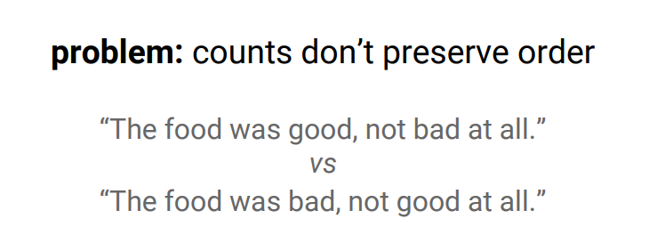
Why Sequence Models?

Slide 36
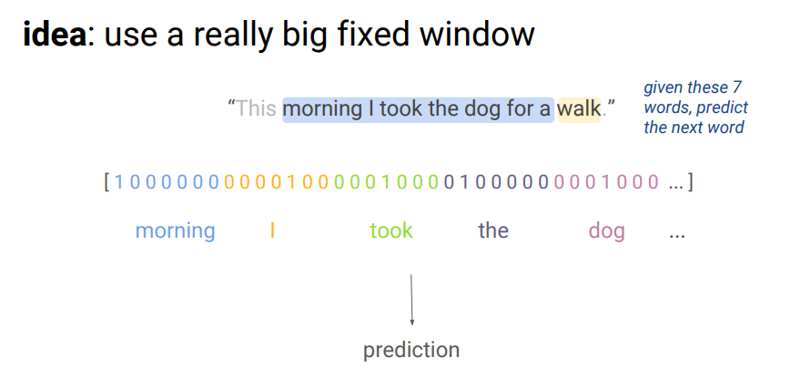
Why Sequence Models?

Slide 37
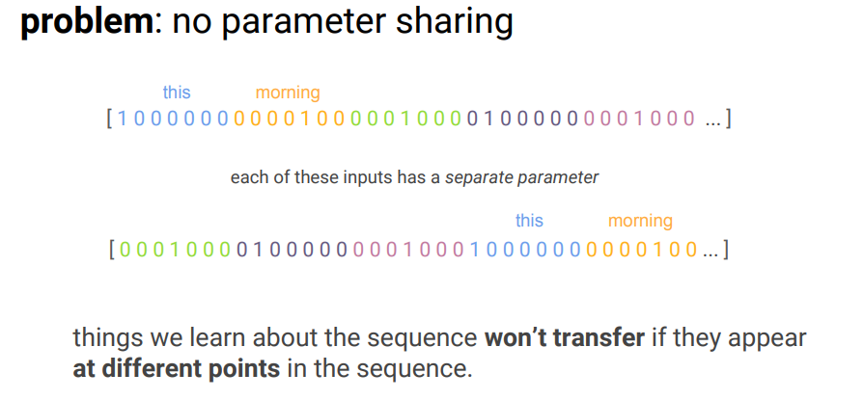
Why Sequence Models?

Slide 38
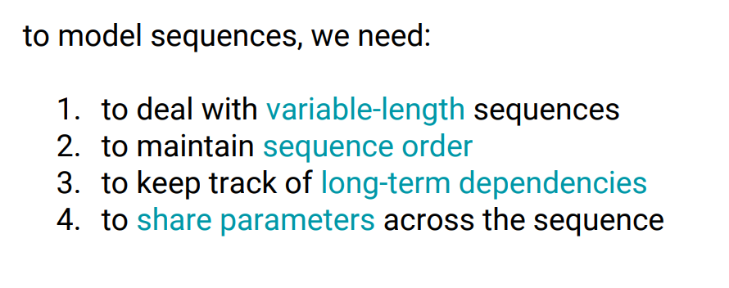
Why Sequence Models?

Slide 39
A Visual Guide to Recurrent Layers in Keras
source: https://amitness.com/2020/04/recurrent-layers-keras/

Slide 40
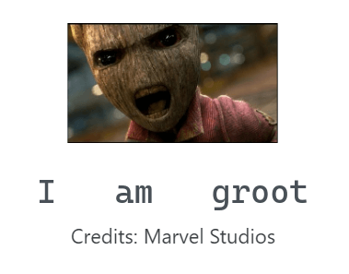
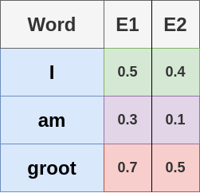
RNN: Single Output
Let’s take a simple example of encoding
For simplicity, let’s assume we used some word embedding to convert each word into 2 numbers.
We could either use one-hot encoding, pretrained word vectors, or learn word embeddings from scratch
https://amitness.com/2020/04/recurrent-layers-keras/

Slide 41
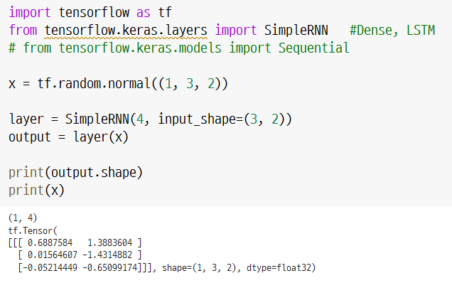
SimpleRNN (1)
SimpleRNN with a Dense layer
to build an architecture for something like sentiment analysis or text classification.

Slide 42
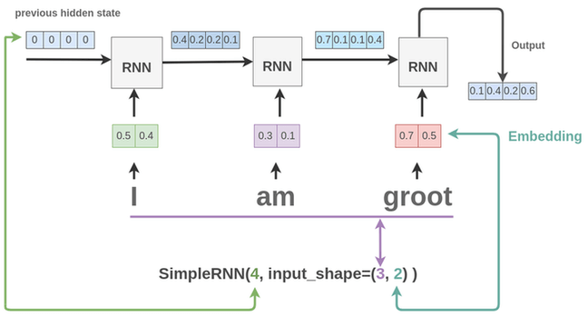
SimpleRNN : Many-to-One
we treat each word as a time-step and the embedding as features.
model.add(layers.SimpleRNN(4,input_shape=(3,2)))

Slide 43
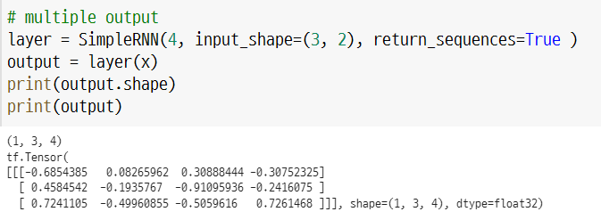
SimpleRNN (3) : return_sequences=True

Slide 44
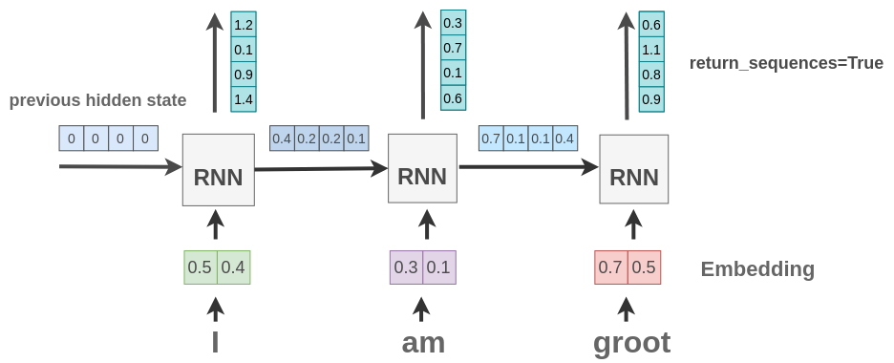
RNN with return_sequences : Many-to-Many
return_sequences = True
True : the output from each unfolded RNN cell is returned instead of only the last cell.
model.add(SimpleRNN(4, input_shape=(3, 2), return_sequences=True))

Slide 45
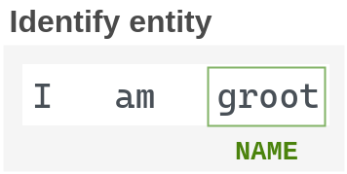
RNN with TimeDistributed : Many-to-Many
Suppose we want to recognize entities in a text.
For example, in our text “I am Groot”, we want to identify “Groot” as a name.

Slide 46
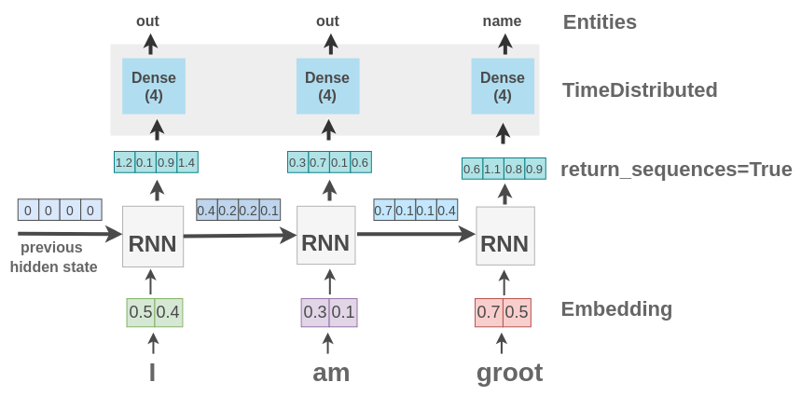
(3) RNN: TimeDistributed Layer
model.add(SimpleRNN(4, input_shape=(3, 2), return_sequences=True))
model.add(TimeDistributed(Dense(4, activation='softmax')))

Slide 47
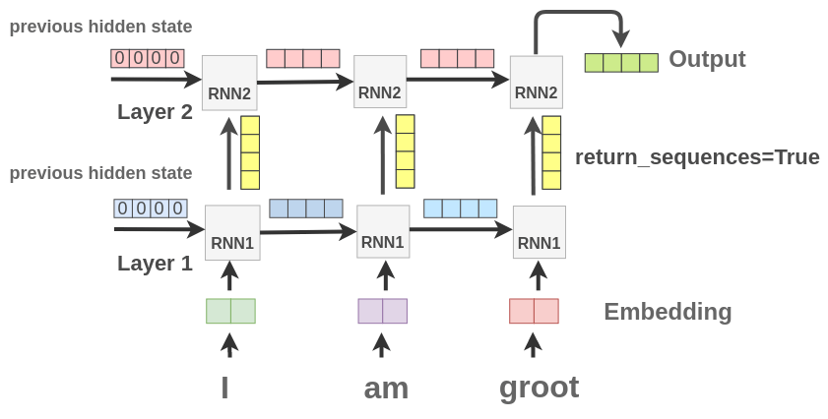
RNN Stacking Layer : Deep but Many-to-One
We can also stack multiple recurrent layers one after another in Keras
model.add(SimpleRNN(4, input_shape=(3, 2), return_sequences=True))
model.add(SimpleRNN(4))

Slide 48
Let’s Code 2: LSTM

Slide 49
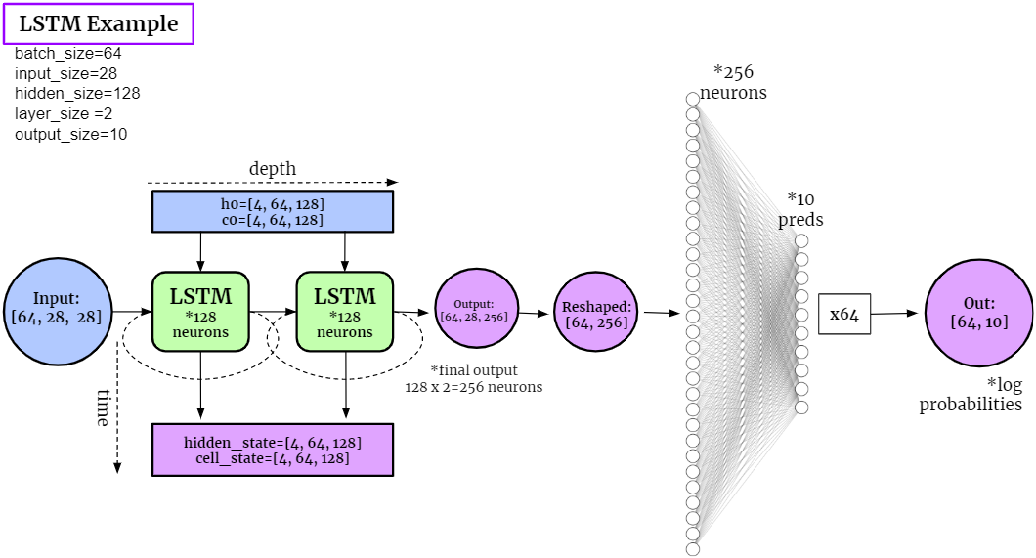
LSTM Example : Parameters

Slide 50
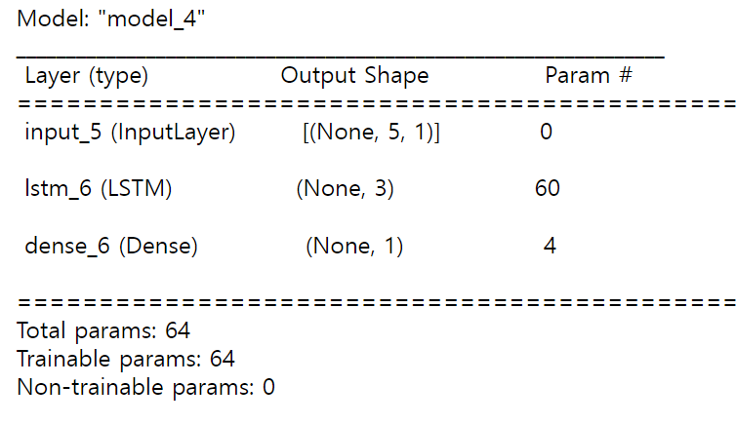
LSTM Example : many-to-one
from keras.models import Model
from keras.layers import Input, Dense, LSTM
import numpy as np
x = np.array([[[1.], [2.], [3.], [4.], [5.]]])
y = np.array([[6.]])
xInput = Input(batch_shape=(None, 5, 1))
xLstm = LSTM(3)(xInput)
xOutput = Dense(1)(xLstm)
model = Model(xInput, xOutput)
model.compile(loss='mean_squared_error', optimizer='adam')
print(model.summary())
model.fit(x, y, epochs=50, batch_size=1, verbose=0)
model.predict(x, batch_size=1)

Slide 51
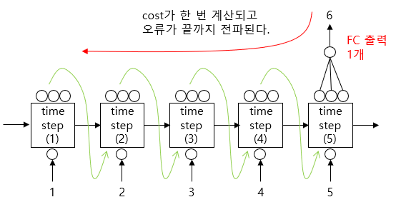
Unfolded LSTM : Many to One
return_sequences=False
The cost is calculated once, and the error is propagated to the end
3 neurons
5 input (time step)

Slide 52
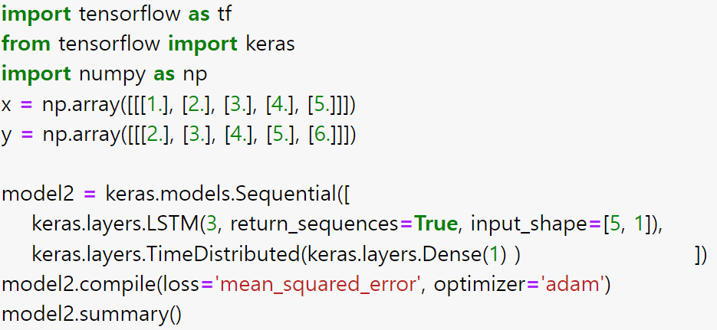
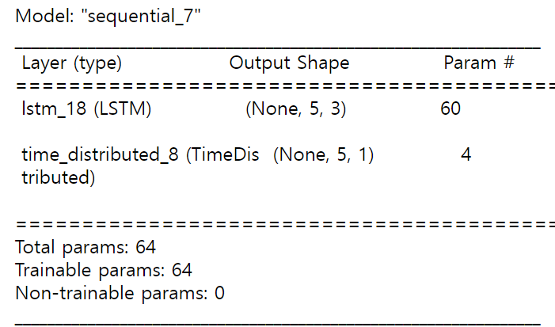
LSTM many-to-many with TimeDistributed Layer
LSTM Output is 5x3(neurons)
Final Output is 5x1

Slide 53

TRUST
2022
KISTI
Korea Institute of Science
and Technology Information

